Slide 1




Supply Chain Analysis
Instructor: Ammar Mustafa

Slide 2

Our Team
Dina Mohamed
Nour sheref
Mariem matemd
Doaa mahmoud
Sohaila Makled

Slide 3
Agenda
Introduction to Supply Chain Analysis
Types of Supply Chain Analytics
Objective
Data overview
Cleaning & Modelling
EDA with python
Dashboards
Analysis Report

Slide 4
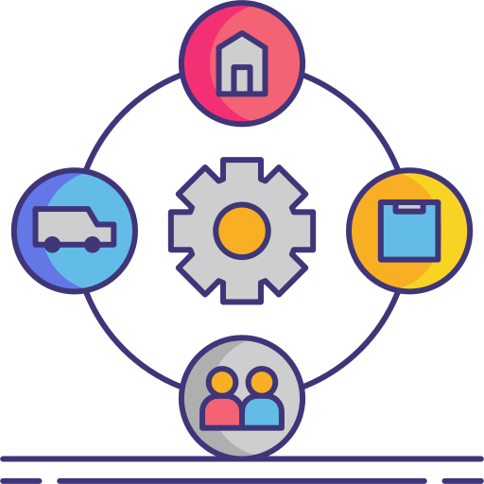
Introduction to Supply Chain Analysis
The supply chain is the network of production and logistics involved in producing and delivering goods to customers. Supply chain analysis involves evaluating each stage of a supply chain, from acquiring raw materials to delivering final products, to identify areas for improvement and efficiency.

Slide 5
Objective
To analyze and optimize the supply chain process by examining sales performance, profitability, stock levels, and supplier efficiency, while leveraging predictive models to support data-driven decision-making.

Slide 6
Data overview
The dataset offers a detailed view of a supply chain across 24 columns, including key data on Product Type, SKU, Price, Stock Levels, Units Sold, and Revenue Generated. It also tracks logistics such as Lead Times, Order Quantities, Shipping Times, Carriers, and Shipping Costs, along with production details like Supplier, Location, Manufacturing Lead Time, and Costs. Additionally, it includes Customer Demographics, Defect Rates, and Transportation Modes, providing a comprehensive overview of both product performance and logistics.

Slide 7
Cleaning & Modelling

Slide 8
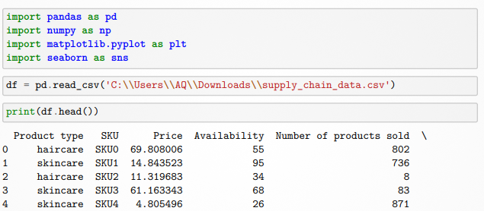
Cleaning & Modelling
First, we imported libraries like Pandas for cleaning, Matplotlib & Seaborn for visualization Then, we uploaded the file and checked the number of rows and columns, and there was 101 rows and 24 columns.

Slide 9
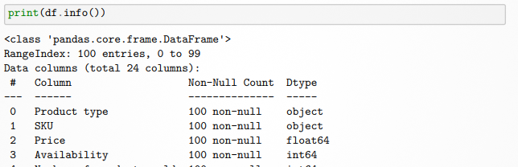
Cleaning & Modelling
second, we checked each column for its data type and the number of null values, Then we examined how many duplicates were in the data and reviewed the format of each column.

Slide 10
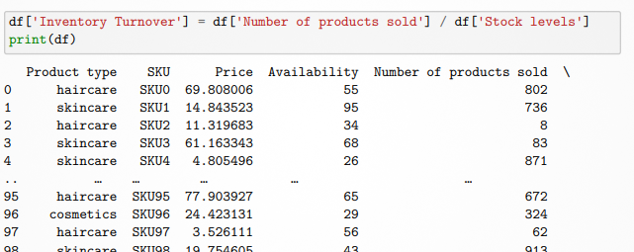
Cleaning & Modelling
A new column titled ‘Inventory Turnover’ has been added to the dataset to assess inventory management effectiveness.

Slide 11
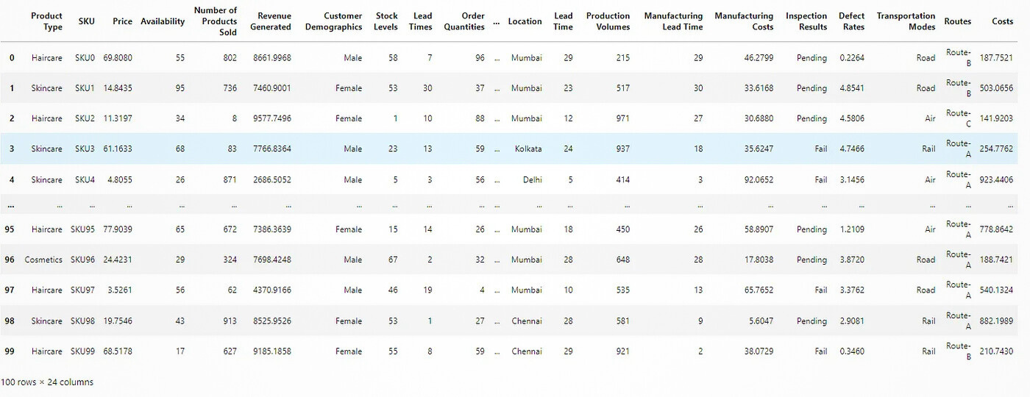
Cleaning & Modelling

Slide 12
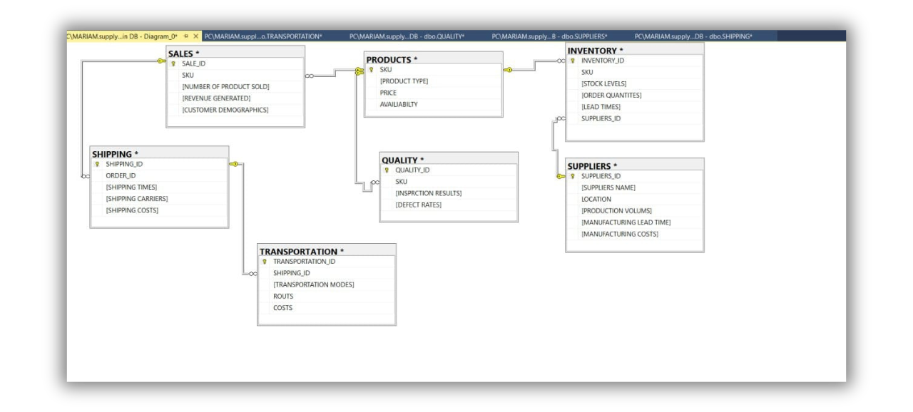
Cleaning & Modelling

Slide 13
EDA with python

Slide 14
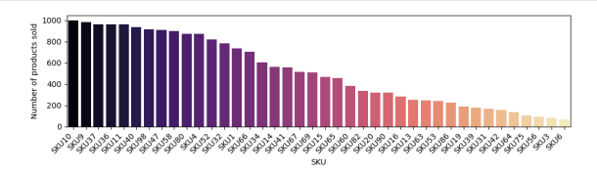
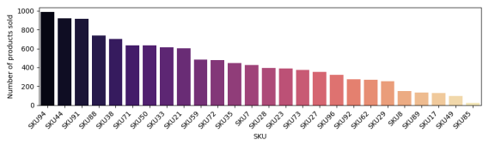
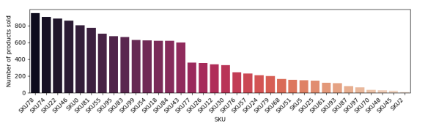

Slide 15
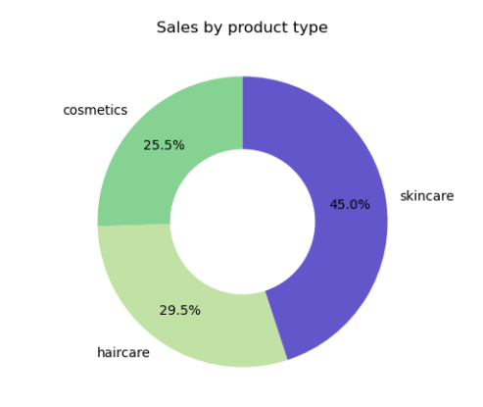

Slide 16
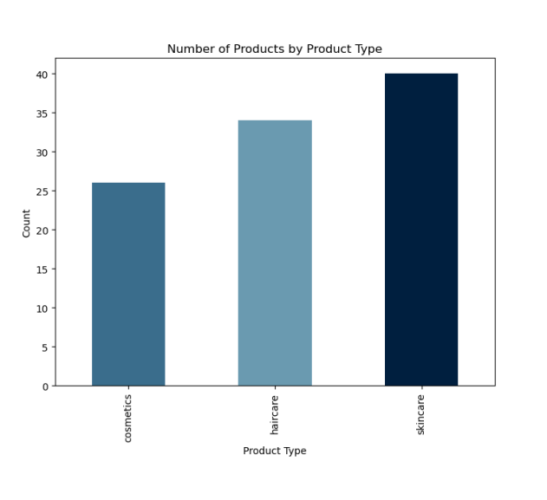

Slide 17
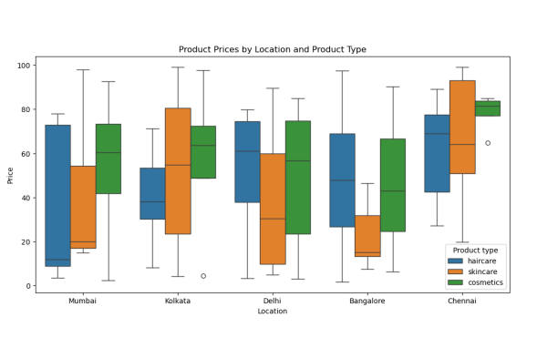

Slide 18
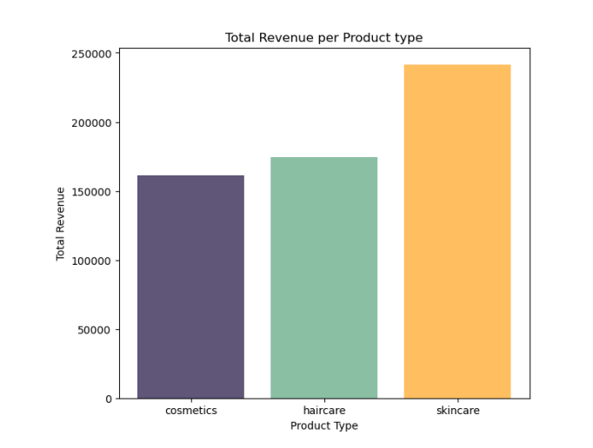

Slide 19
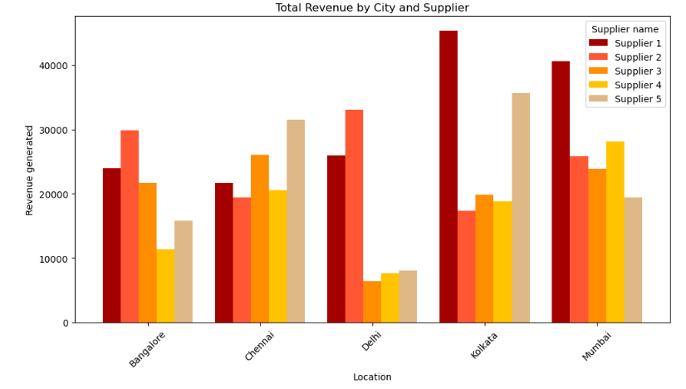

Slide 20
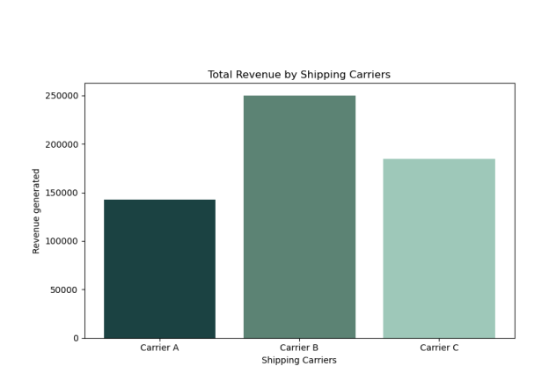

Slide 21
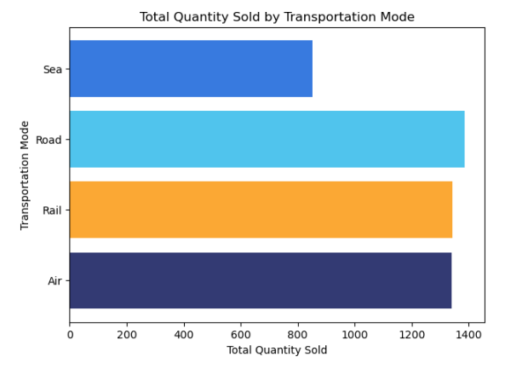

Slide 22
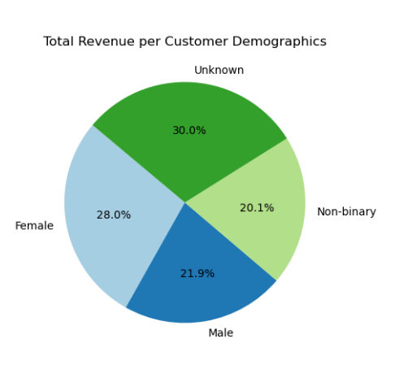

Slide 24
Dashboards

Slide 25
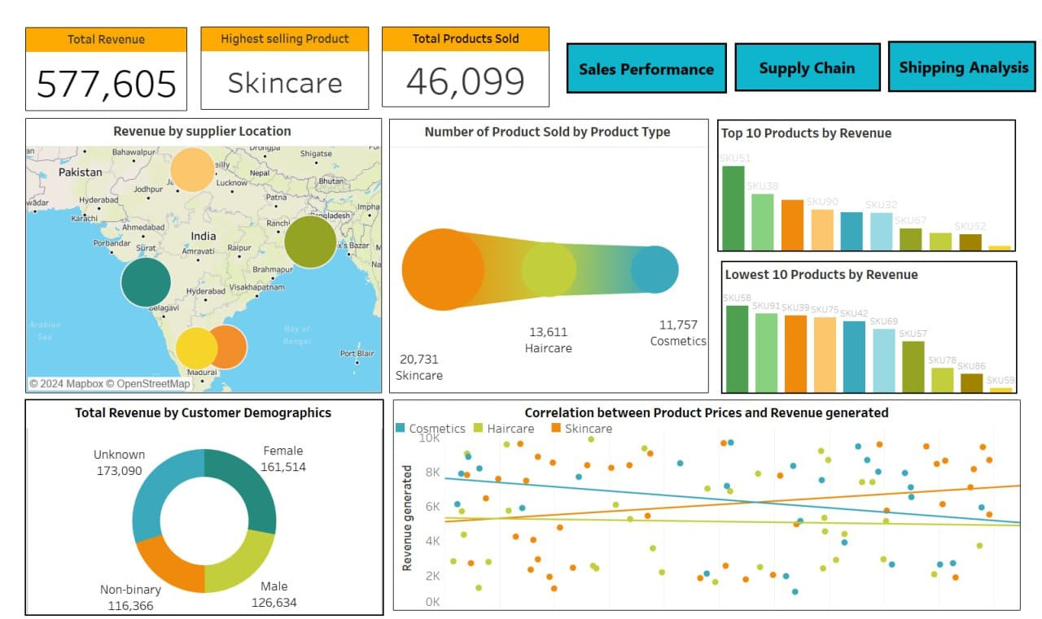

Slide 26
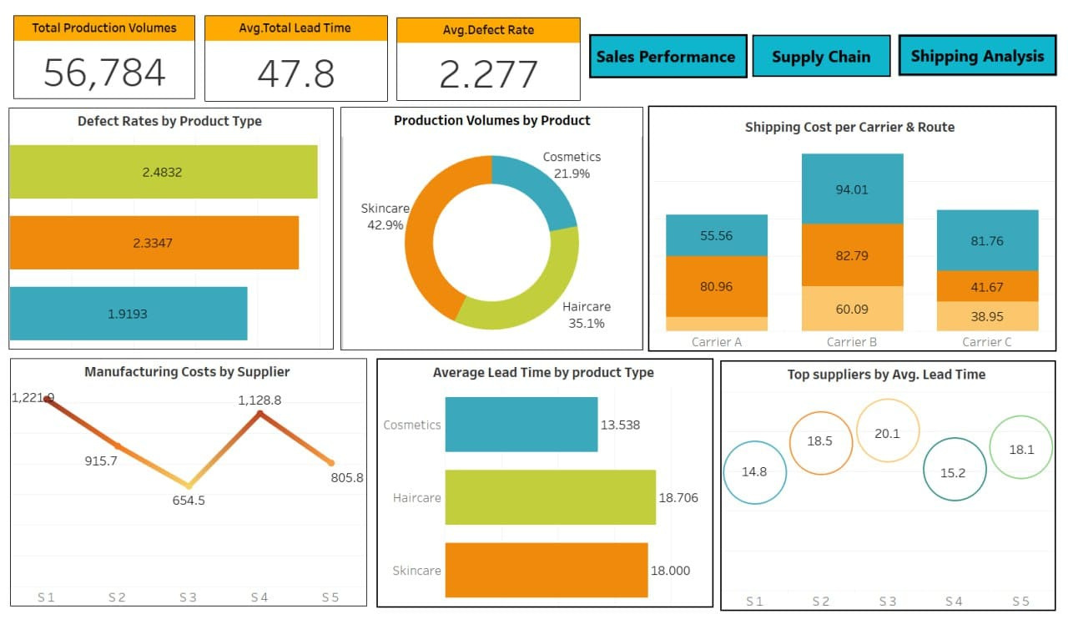

Slide 27
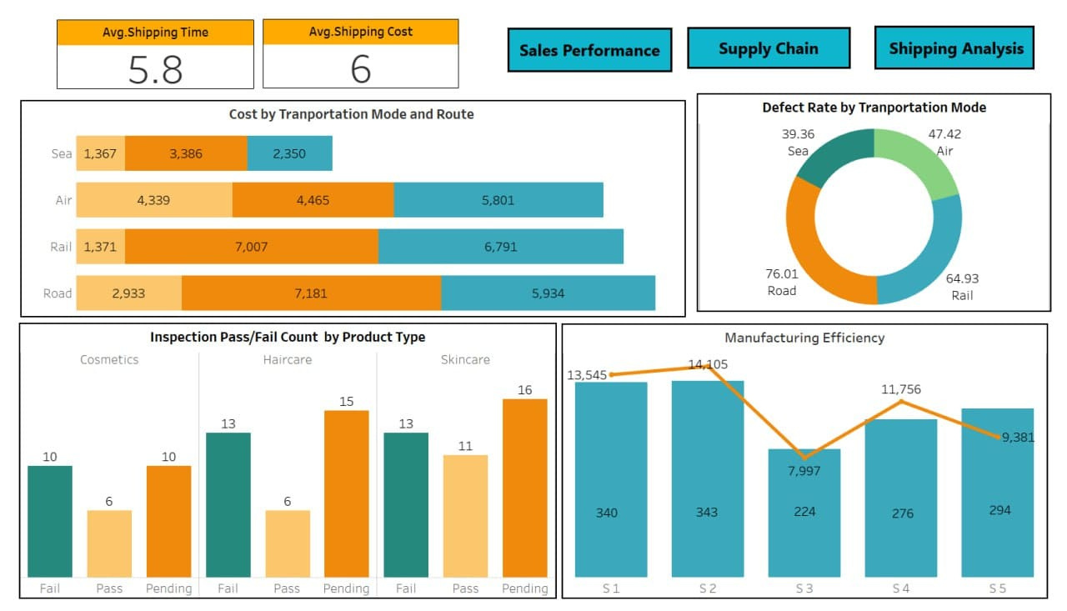

Slide 28
Analysis Report

Slide 29
Sales Dashboard
The Sales Dashboard provides valuable insights into overall sales performance, number of products sold, revenue generated, and customer behavior. One significant observation is that skincare products emerge as the top-selling category, leading in both the number of products sold and price point. This suggests that skincare products are a key revenue driver.
The Top 10 Products by Revenue are predominantly high-performing SKUs across skincare, haircare, and cosmetics categories. Skincare products dominate this list, solidifying their position as the leading revenue driver for the business.
In terms of customer demographics, females generate €161,514, accounting for approximately 28% of total revenue, while males contribute €126,634, which is about 22%. These figures highlight the importance of targeting female consumers, although males also represent a significant portion of sales.
When examining product preferences, females show the highest total order quantity for skincare products, reaffirming their strong demand in this category. For males, haircare products lead in total order quantity, indicating a clear preference within this demographic.

Slide 30
Supply Chain Dashboard
The Supply Chain Dashboard provides key insights into production volume, defect rates, supplier costs, and shipping costs across product categories. A significant observation is that haircare products exhibit the highest defect rate, while cosmetics have the lowest. This suggests that haircare manufacturing processes may require attention to reduce defects and improve product quality.
Another key insight is that skincare products have the highest production volume compared to other categories. This indicates that skincare is a primary focus area.
In terms of manufacturing costs, Supplier 1 incurs the highest expenses, while Supplier 3 is the most cost-effective. Optimizing supplier selection or negotiating better terms with Supplier 1 may lead to significant cost savings without sacrificing quality or lead time.
Shipping costs vary significantly between carriers. Carrier B has the highest shipping costs, whereas Carrier A is the most economical. Promoting the use of Carrier A where feasible can help reduce overall logistics expenses, improving the supply chain's profitability.
Additionally, Supplier 1 stands out with the shortest average lead time. While this is beneficial for time-sensitive operations, the higher associated costs warrant a closer examination to ensure that the trade-off between cost and lead time is justified.

Slide 31
Shipping Dashboard
The Shipping Dashboard offers comprehensive insights into transportation modes, inspection results, and manufacturing efficiency. One key finding is that Route C consistently proves to be the most cost-effective across all transportation modes. This suggests that optimizing shipments along this route can result in significant cost savings for the company.
Road transportation, however, incurs the highest costs among all transportation modes. While road might offer flexibility, its high cost warrants a review of other modes or the possibility of cost-saving strategies when using this option.
Inspection results show that skincare products account for the highest pending and passing rates, while both skincare and haircare products equally contribute to the highest failure rates. These findings indicate that skincare is both a strong performer and a potential concern, requiring a deeper look into its inspection processes to address quality issues.
Regarding manufacturing efficiency, Supplier 2 demonstrates the highest production volume but also suffers from the longest manufacturing lead time. This trade-off between production output and lead time may require balancing efficiency with the need for timely delivery.
Lastly, road transportation is linked to the highest defect rate, further reinforcing the need to assess alternative transportation modes to improve product quality and reduce overall defect rates.

Slide 32

Thank you!

